Slide 1

Illegal Immigration
&
SB 1070

Slide 2


Why Arizona Had to Act
Illegal immigration is paid for by Arizona taxpayers
F.A.I.R. - cost: $2.7 billion a year
  Low est./$400 million medical
  Low est./$80 million incarceration
  Low est./$820 million education

Slide 3
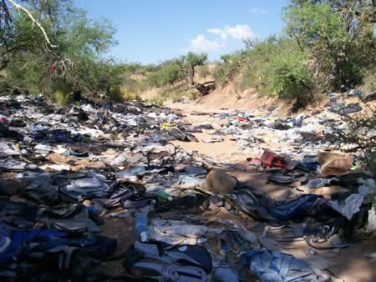
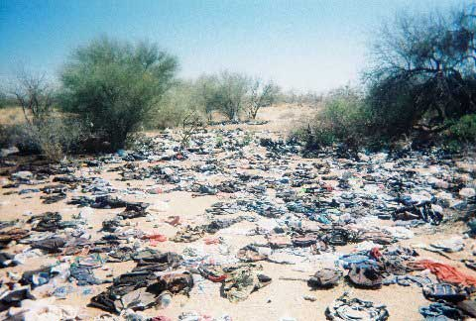
Why Arizona Had to Act
Environmental Damage

Slide 4
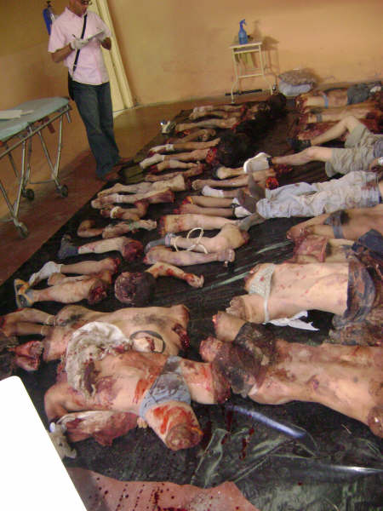
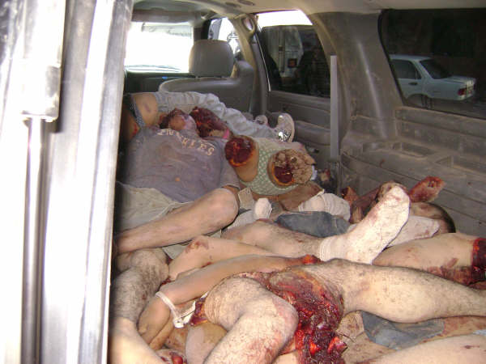
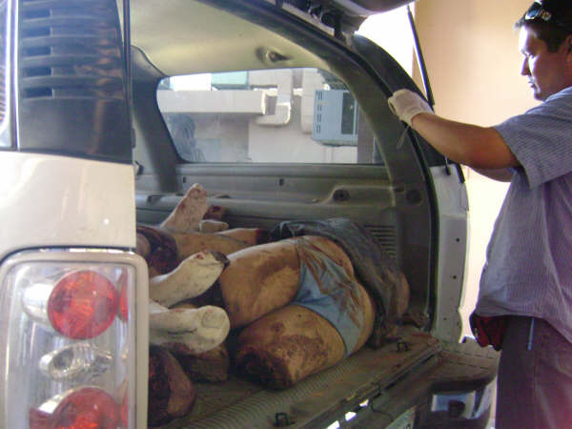
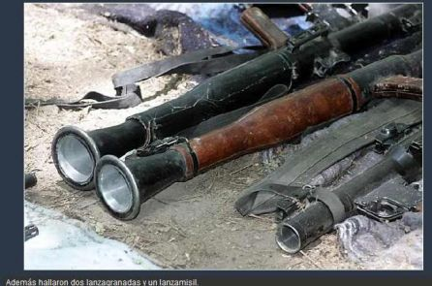
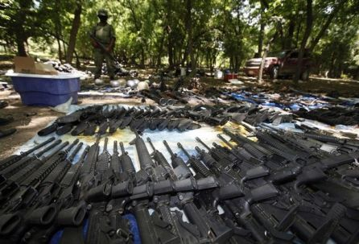
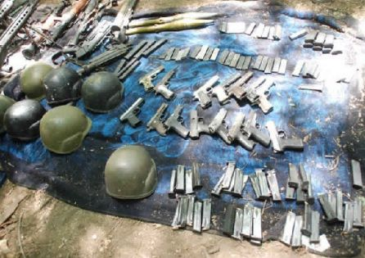
Why Arizona Had to Act
National Security

Slide 5
Why Arizona Had to Act
Criminal Aliens
  Approx. 20% of jail population is illegal
  88 in custody/106 counts of murder
  DUI- 50% are illegal
  Poss. of dangerous drugs for sale:210/413 or 51% are illegal
  Poss. of narcotic drugs for sale: 199/385 or 52% are illegal

Slide 6

Why PLEA Had to Act
COMMUNITY RAVAGED
Crimes directly associated with illegal immigration that impact the quality of life in the community:
  Murder: (6 out of 10 Hispanics / 3 of 6 by illegals)
  Human trafficking: 291 in custody for kidnapping
  Home Invasions
  Drop houses

Slide 8

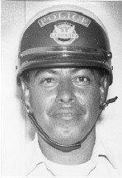

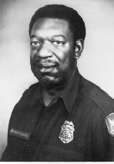
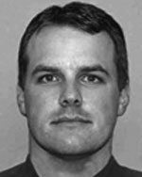
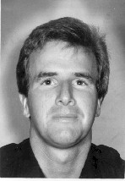

Why PLEA Had to Act
COPS AT RISK
Phoenix Police Officers killed by illegals
Ignacio Conchos - 82
Shane Figueroa - 08
John Davis - 82
Nick Erfle - 07
Kenneth Collings - 88
Marc Atkinson-99

Slide 9
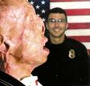
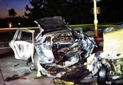
Why PLEA Had to Act
COPS AT RISK
Phoenix Police Officers seriously injured by illegals:
  Jim Kliewer - 97
  Jerry Kilgore - 97
  Brian Wilbur - 97
  Jason Schecterle - 01
  Robert Sitek - 03
  Brent Glidewell - 07

Slide 10
Context of S.B. 1070?
8 USC § 1373
Communication between government agencies and the Immigration and Naturalization Service
In general Notwithstanding any other provision of Federal, State, or local law, a Federal, State, or local government entity or official may not prohibit, or in any way restrict, any government entity or official from sending to, or receiving from, the Immigration and Naturalization Service information regarding the citizenship or immigration status, lawful or unlawful, of any individual.
(b) Additional authority of government entities Notwithstanding any other provision of Federal, State, or local law, no person or agency may prohibit, or in any way restrict, a Federal, State, or local government entity from doing any of the following with respect to information regarding the immigration status, lawful or unlawful, of any individual:
  Sending such information to, or requesting or receiving such information from, the Immigration and Naturalization Service.
(2) Maintaining such information.
(3) Exchanging such information with any other Federal, State, or local government entity.
(c) Obligation to respond to inquiries The Immigration and Naturalization Service shall respond to an inquiry by a Federal, State, or local government agency, seeking to verify or ascertain the citizenship or immigration status of any individual within the jurisdiction of the agency for any purpose authorized by law, by providing the requested verification or status information.

Slide 11
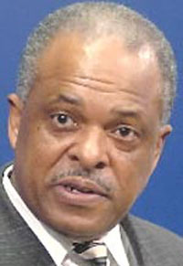
Context of S.B. 1070?
Phoenix P.D. had a sanctuary city blind-dye illegal immigration policy:
  Had to have another crime, another victim and more damage before an officer could contact ICE

Slide 12

Context of S.B. 1070?
PLEA forced a change to the policy:
  Press conference: October 8, 2007
  8/10 of our officers saw a serious problem with the policy
9 months of vociferous public debate:
  Blue ribbon panel
  Community meetings
  Racial profiling
  “Routine immigration enforcement”
  Divert resources away from “real crime”
  Cost/unfunded mandate

Slide 13
Context of S.B. 1070?
End Result- NEW POLICY
3,000+ illegals turned over to ICE without a SINGLE complaint of racial profiling, biased policing, or civil rights violation!
No additional costs, crimes, or victims
2 year test-drive of SB1070

Slide 14

Context of S.B. 1070?

Slide 15
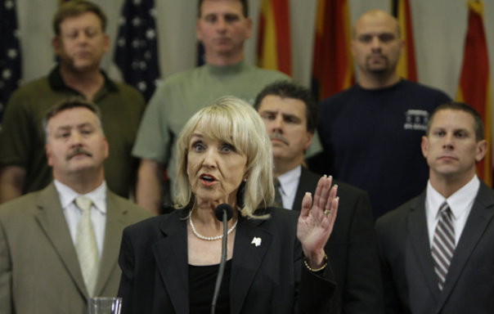
S.B. 1070 Court Ruling

Slide 16
Senate bill 1070
An act
Amending Title 11, Chapter 7, Arizona Revised Statutes, by adding Article 8;
amending Title 13, Chapter 15, Arizona Revised Statutes, by adding section
13-1509; amending section 13-2319, Arizona Revised Statutes; amending Title
13, Chapter 29, Arizona Revised Statutes, by adding sections 13-2928 and
13-2929; amending sections 23-212, 23-212.01, 23-214 and 28-3511, Arizona
Revised Statutes; amending Title 41, Chapter 12, Article 2, Arizona Revised
Statutes, by adding section 41-1724; relating to unlawfully present aliens.
S.B. 1070
Be it enacted by the legislature of the State of Arizona:
Section 1.
Intent
The legislature finds that there is a compelling interest in the cooperative
enforce ment of federal immigration laws throughout all of Arizona.
The legislature declares that the intent of this act is to make attrition
through enforcement the public policy of all state and local government
agencies in Arizona. The provisions of this act are intended to work together
to discourage and deter the unlawful entry and presence of
aliens and economic activity by persons unlawfully present in the United
States.
Section 2.
Title 11, Chapter 7, Arizona Revised Statutes, is amended by adding
Article 8, to read:
Article 8. Enforcement of Immigration Laws 11-1051. Cooperation and assistance
in enforcement of immigration laws; indemnification
A. No official or agency of this state or a county, city, town or other political
subdivision of this state may adopt a policy that limits or restricts
the enforcement of federal immigration laws to less than the full extent
permitted by federal law.
B. For any lawful stop, detention or arrest made by a law enforcement
official or agency of this state or a county, city, town or other political
subdivision of this state in the enforcement of any other law or ordinance
of a county, city or town of this state where reasonable suspicion
exists that the person is an alien and is unlawfully present in the United
States, a reasonable attempt shall be made, when practicable, to determine
the immigration status of the person. The person’s immigration
status shall be verified with the federal government pursuant to United
States Code Section 1373(c). A law enforcement official or agency
of this state or a county, city, town or other political subdivision of this
state may not consider race, color or national origin in implementing the
requirements of this subsection except to the extent permitted by the
United States or Arizona Constitution. A person is presumed to not be
an alien who is unlawfully present in the United States if the person provides
to the law enforcement officer or agency any of the following:
1. A valid Arizona driver license.
2. A valid Arizona nonoperating identification license.
3. A valid tribal enrollment card or other form of tribal identification.
4. If the entity requires proof of legal presence in the United States
before issuance, any valid United States federal, state or local government
issued identification.
C. If an alien who is unlawfully present in the United States is convicted
of a violation of state or local law, on discharge from imprisonment or
assessment of any fine that is imposed, the alien shall be transferred immediately
to the custody of the United States Immigration and Customs
Enforcement or the United States Customs and Border Protection.
D. Notwithstanding any other law, a law enforcement agency may securely
transport an alien who is unlawfully present in the United States
and who is in the agency’s custody to a federal facility in this state or to
any other point of transfer into federal custody that is outside the jurisdiction
of the law enforcement agency.
E. In the implementation of this section, an alien’s immigration status
may be determined by:
1. A law enforcement officer who is authorized by
The law: Prohibits the state or any county, city, town or other political subdivision from limiting or restricting the enforcement of federal immigration laws to less than the full extent permitted by federal law.
Judge Bolton's order: The United States did not make any arguments to have this provision enjoined. The provision took effect on Thursday (July 29).
Az Rep.

Slide 17
2. The United States Immigration and Customs Enforcement or the
United States Customs and Border Protection pursuant to 8 United
States Code Section 1373(c).
F. Except as provided in federal law, officials or agencies of this state
and counties, cities, towns and other political subdivisions of this state
may not be prohibited or in any way be restricted from sending, receiving
or maintaining information relating to the immigration status of any
individual or exchanging that information with any other federal, state or
local governmental entity for the following official purposes:
1. Determining eligibility for any public benefit, service or license provided
by any federal, state, local or other political subdivision of this
state.
2. Verifying any claim of residence or domicile if determination of
residence or domicile is required under the laws of this state or a judicial
order issued pursuant to a civil or criminal proceeding in this
state.
3. If the person is an alien, determining whether the person is in compliance
with the federal registration laws prescribed by Title ii, Chapter
7 Of the Federal Immigration and Nationality Act.
4. Pursuant to 8 United States Code Section 1373 and 8 United States
Code Section 1644.
G. This section does not implement, authorize or establish and shall not
be construed to implement, authorize or establish the Real ID Act of
2005 (P.L. 109-13, Division B; 119 Stat. 302), Including the use of a radio
frequency identification chip.
H. A person who is a legal resident of this state may bring an action in
superior court to challenge any official or agency of this state or a county,
city, town or other political subdivision of this state that adopts or implements
a policy that limits or restricts the enforcement of federal immigration
laws, including 8 United States Code Sections 1373 and 1644,
to less than the full extent permitted by federal law. If there is a judicial
finding that an entity has violated this section, the court shall order that
the entity pay a civil penalty of not less than five hundred dollars and
not more than five thousand dollars for each day that the policy has remained
in effect after the filing of an action pursuant to this subsection.
I. A court shall collect the civil penalty prescribed in subsection H of this
section and remit the civil penalty to the state treasurer for deposit in
the Gang and Immigration Intelligence Team Enforcement Mission Fund
established by section 41-1724.
J. The court may award court costs and reasonable attorney fees to any
person or any official or agency of this state or a county, city, town or
other political subdivision of this state that prevails by an adjudication
on the merits in a proceeding brought pursuant to this section.
K. Except in relation to matters in which the officer is adjudged to have
acted in bad faith, a law enforcement officer is indemnified by the law
enforcement officer’s agency against reasonable costs and expenses, including
attorney fees, incurred by the officer in connection with any action,
suit or proceeding brought pursuant to this section in which the officer
may be a defendant by reason of the officer being or having been a
member of the law enforcement agency.
L. This section shall be implemented in a manner consistent with federal
laws regulating immigration, protecting the civil rights of all persons and
respecting the privileges and immunities of United States citizens.
Section 3.
Title 13, Chapter 15, Arizona Revised Statutes, is amended by adding
section 13-1509, to read:
13-1509. Willful failure to complete or carry an alien registration document;
assessment; exception; authenticated records; classification
A. In addition to any violation of federal law, a person is guilty of willful
failure to complete or carry an alien registration document if the person
is in violation of 8 United States Code Section 1304(e) or 1306(A).
B. In the enforcement of this section, an alien’s immigration status may
be determined by:
1. A law enforcement officer who is authorized by the federal government
to verify or ascertain an alien’s immigration status.
The law: Allows citizens to sue agencies or municipalities (not officers) for police policies that restrict contact or interaction with ICE. The penalty can range from $500 to $5000 a day
Judge Bolton's order: The United States did not make any arguments to have this provision enjoined. The provision took effect on Thursday (July 29).

Slide 18

Senate bill 1070
An act
Amending Title 11, Chapter 7, Arizona Revised Statutes, by adding Article 8;
amending Title 13, Chapter 15, Arizona Revised Statutes, by adding section
13-1509; amending section 13-2319, Arizona Revised Statutes; amending Title
13, Chapter 29, Arizona Revised Statutes, by adding sections 13-2928 and
13-2929; amending sections 23-212, 23-212.01, 23-214 and 28-3511, Arizona
Revised Statutes; amending Title 41, Chapter 12, Article 2, Arizona Revised
Statutes, by adding section 41-1724; relating to unlawfully present aliens.
S.B. 1070
Be it enacted by the legislature of the State of Arizona:
Section 1.
Intent
The legislature finds that there is a compelling interest in the cooperative
enforce ment of federal immigration laws throughout all of Arizona.
The legislature declares that the intent of this act is to make attrition
through enforcement the public policy of all state and local government
agencies in Arizona. The provisions of this act are intended to work together
to discourage and deter the unlawful entry and presence of
aliens and economic activity by persons unlawfully present in the United
States.
Section 2.
Title 11, Chapter 7, Arizona Revised Statutes, is amended by adding
Article 8, to read:
Article 8. Enforcement of Immigration Laws 11-1051. Cooperation and assistance
in enforcement of immigration laws; indemnification
A. No official or agency of this state or a county, city, town or other political
subdivision of this state may adopt a policy that limits or restricts
the enforcement of federal immigration laws to less than the full extent
permitted by federal law.
B. For any lawful stop, detention or arrest made by a law enforcement
official or agency of this state or a county, city, town or other political
subdivision of this state in the enforcement of any other law or ordinance
of a county, city or town of this state where reasonable suspicion
exists that the person is an alien and is unlawfully present in the United
States, a reasonable attempt shall be made, when practicable, to determine
the immigration status of the person. The person’s immigration
status shall be verified with the federal government pursuant to United
States Code Section 1373(c). A law enforcement official or agency
of this state or a county, city, town or other political subdivision of this
state may not consider race, color or national origin in implementing the
requirements of this subsection except to the extent permitted by the
United States or Arizona Constitution. A person is presumed to not be
an alien who is unlawfully present in the United States if the person provides
to the law enforcement officer or agency any of the following:
1. A valid Arizona driver license.
2. A valid Arizona nonoperating identification license.
3. A valid tribal enrollment card or other form of tribal identification.
4. If the entity requires proof of legal presence in the United States
before issuance, any valid United States federal, state or local government
issued identification.
C. If an alien who is unlawfully present in the United States is convicted
of a violation of state or local law, on discharge from imprisonment or
assessment of any fine that is imposed, the alien shall be transferred immediately
to the custody of the United States Immigration and Customs
Enforcement or the United States Customs and Border Protection.
D. Notwithstanding any other law, a law enforcement agency may securely
transport an alien who is unlawfully present in the United States
and who is in the agency’s custody to a federal facility in this state or to
any other point of transfer into federal custody that is outside the jurisdiction
of the law enforcement agency.
E. In the implementation of this section, an alien’s immigration status
may be determined by:
1. A law enforcement officer who is authorized by
The law: Allowed law enforcement officers, through ICE, when practicable, to determine the immigration status of all individuals arrested in Arizona if there was reasonable suspicion that the person was in the country illegally. Valid ID (computer checks suffice as ID) stopped immigration inquiries. Everyone is presumed to be in the country legally.
Judge Bolton's order: Judge Bolton enjoined this provision. She determined that the provision required law enforcement officers to determine the immigration status of ALL individuals arrested in Arizona, not just those who are reasonably suspected of being in the country illegally (nearly 37,000 people were “arrested” last year in Tucson alone).
According to Judge Bolton, this provision conflicted with federal immigration policy as it would result in the harassment of lawfully present aliens and will burden federal resources.
1

Slide 19
Judge Bolton believed that Congress intended to regulate immigration through a uniform national policy and prevent lawfully-present aliens from being subjected to “inquisitorial practices and police surveillance.” She held, because of her interpretation, that this provision will “place lawfully present aliens (and U.S. citizens) in continual jeopardy of having to demonstrate their lawful status.” She also noted that many lawfully present aliens and U.S. Citizens will not have readily available documentation to prove their legal status.
Additionally, Judge Bolton concluded that the number of immigration status inquiries that will emanate from this provision will direct resources away from the priorities and functions of federal agencies, and that the provision therefore conflicts with federal immigration policy.
As a result of this interpretation, Judge Bolton ruled that this provision is preempted.
Senate bill 1070
An act
Amending Title 11, Chapter 7, Arizona Revised Statutes, by adding Article 8;
amending Title 13, Chapter 15, Arizona Revised Statutes, by adding section
13-1509; amending section 13-2319, Arizona Revised Statutes; amending Title
13, Chapter 29, Arizona Revised Statutes, by adding sections 13-2928 and
13-2929; amending sections 23-212, 23-212.01, 23-214 and 28-3511, Arizona
Revised Statutes; amending Title 41, Chapter 12, Article 2, Arizona Revised
Statutes, by adding section 41-1724; relating to unlawfully present aliens.
S.B. 1070
Be it enacted by the legislature of the State of Arizona:
Section 1.
Intent
The legislature finds that there is a compelling interest in the cooperative
enforce ment of federal immigration laws throughout all of Arizona.
The legislature declares that the intent of this act is to make attrition
through enforcement the public policy of all state and local government
agencies in Arizona. The provisions of this act are intended to work together
to discourage and deter the unlawful entry and presence of
aliens and economic activity by persons unlawfully present in the United
States.
Section 2.
Title 11, Chapter 7, Arizona Revised Statutes, is amended by adding
Article 8, to read:
Article 8. Enforcement of Immigration Laws 11-1051. Cooperation and assistance
in enforcement of immigration laws; indemnification
A. No official or agency of this state or a county, city, town or other political
subdivision of this state may adopt a policy that limits or restricts
the enforcement of federal immigration laws to less than the full extent
permitted by federal law.
B. For any lawful stop, detention or arrest made by a law enforcement
official or agency of this state or a county, city, town or other political
subdivision of this state in the enforcement of any other law or ordinance
of a county, city or town of this state where reasonable suspicion
exists that the person is an alien and is unlawfully present in the United
States, a reasonable attempt shall be made, when practicable, to determine
the immigration status of the person. The person’s immigration
status shall be verified with the federal government pursuant to United
States Code Section 1373(c). A law enforcement official or agency
of this state or a county, city, town or other political subdivision of this
state may not consider race, color or national origin in implementing the
requirements of this subsection except to the extent permitted by the
United States or Arizona Constitution. A person is presumed to not be
an alien who is unlawfully present in the United States if the person provides
to the law enforcement officer or agency any of the following:
1. A valid Arizona driver license.
2. A valid Arizona nonoperating identification license.
3. A valid tribal enrollment card or other form of tribal identification.
4. If the entity requires proof of legal presence in the United States
before issuance, any valid United States federal, state or local government
issued identification.
C. If an alien who is unlawfully present in the United States is convicted
of a violation of state or local law, on discharge from imprisonment or
assessment of any fine that is imposed, the alien shall be transferred immediately
to the custody of the United States Immigration and Customs
Enforcement or the United States Customs and Border Protection.
D. Notwithstanding any other law, a law enforcement agency may securely
transport an alien who is unlawfully present in the United States
and who is in the agency’s custody to a federal facility in this state or to
any other point of transfer into federal custody that is outside the jurisdiction
of the law enforcement agency.
E. In the implementation of this section, an alien’s immigration status
may be determined by:
1. A law enforcement officer who is authorized by
1

Slide 20
2. The United States Immigration and Customs Enforcement or the
United States Customs and Border Protection pursuant to 8 United
States Code Section 1373(c).
F. Except as provided in federal law, officials or agencies of this state
and counties, cities, towns and other political subdivisions of this state
may not be prohibited or in any way be restricted from sending, receiving
or maintaining information relating to the immigration status of any
individual or exchanging that information with any other federal, state or
local governmental entity for the following official purposes:
1. Determining eligibility for any public benefit, service or license provided
by any federal, state, local or other political subdivision of this
state.
2. Verifying any claim of residence or domicile if determination of
residence or domicile is required under the laws of this state or a judicial
order issued pursuant to a civil or criminal proceeding in this
state.
3. If the person is an alien, determining whether the person is in compliance
with the federal registration laws prescribed by Title ii, Chapter
7 Of the Federal Immigration and Nationality Act.
4. Pursuant to 8 United States Code Section 1373 and 8 United States
Code Section 1644.
G. This section does not implement, authorize or establish and shall not
be construed to implement, authorize or establish the Real ID Act of
2005 (P.L. 109-13, Division B; 119 Stat. 302), Including the use of a radio
frequency identification chip.
H. A person who is a legal resident of this state may bring an action in
superior court to challenge any official or agency of this state or a county,
city, town or other political subdivision of this state that adopts or implements
a policy that limits or restricts the enforcement of federal immigration
laws, including 8 United States Code Sections 1373 and 1644,
to less than the full extent permitted by federal law. If there is a judicial
finding that an entity has violated this section, the court shall order that
the entity pay a civil penalty of not less than five hundred dollars and
not more than five thousand dollars for each day that the policy has remained
in effect after the filing of an action pursuant to this subsection.
I. A court shall collect the civil penalty prescribed in subsection H of this
section and remit the civil penalty to the state treasurer for deposit in
the Gang and Immigration Intelligence Team Enforcement Mission Fund
established by section 41-1724.
J. The court may award court costs and reasonable attorney fees to any
person or any official or agency of this state or a county, city, town or
other political subdivision of this state that prevails by an adjudication
on the merits in a proceeding brought pursuant to this section.
K. Except in relation to matters in which the officer is adjudged to have
acted in bad faith, a law enforcement officer is indemnified by the law
enforcement officer’s agency against reasonable costs and expenses, including
attorney fees, incurred by the officer in connection with any action,
suit or proceeding brought pursuant to this section in which the officer
may be a defendant by reason of the officer being or having been a
member of the law enforcement agency.
L. This section shall be implemented in a manner consistent with federal
laws regulating immigration, protecting the civil rights of all persons and
respecting the privileges and immunities of United States citizens.
Section 3.
Title 13, Chapter 15, Arizona Revised Statutes, is amended by adding
section 13-1509, to read:
13-1509. Willful failure to complete or carry an alien registration document;
assessment; exception; authenticated records; classification
A. In addition to any violation of federal law, a person is guilty of willful
failure to complete or carry an alien registration document if the person
is in violation of 8 United States Code Section 1304(e) or 1306(A).
B. In the enforcement of this section, an alien’s immigration status may
be determined by:
1. A law enforcement officer who is authorized by the federal government
to verify or ascertain an alien’s immigration status.
The law: Made it a state crime to violate federal alien registration laws, and created criminal penalties. This is consistent with 8 USC
Judge Bolton's order: Judge Bolton enjoined this provision. In interpreting this provision, Judge Bolton relied on federal law stating that the federal government's system for alien registration precludes states from enacting registration laws that conflict with or supplement federal law.
According to Judge Bolton, by establishing state criminal penalties for a violation of federal alien registration laws, SB 1070 supplements federal law. Judge Bolton also found that SB 1070 supplemented the federal scheme in a way that conflicts with federal immigration policy, which envisions a uniform federal registration system. Therefore, Judge Bolton determined that this section is preempted
2

Slide 21
The law: Stated that it is unlawful for an illegal immigrant to apply for work, solicit work in a public place, or perform work as an employee or independent contractor. The provision also imposed criminal penalties on aliens who violate this section.
Judge Bolton's order: Judge Bolton enjoined this provision. She determined that the provision was preempted by existing federal law governing the employment of aliens. Specifically, the federal government chose not to impose criminal penalties on illegal immigrants who work in the United States. Instead, the federal government determined that it could best deter the hiring of illegal immigrants by imposing criminal sanctions on employers that do the hiring.
According to federal law, when a discrete area of a federally regulated field is deliberately left unregulated, there is a presumption that it was the federal government's policy to leave that discrete area unregulated. Therefore, state laws that regulate that particular subject are presumed to be preempted.
or an entity that knows or has reason to know that the person or persons
transported or to be transported are not United States citizens,
permanent resident aliens or persons otherwise lawfully in this state
or have attempted to enter, entered or remained in the United States
in violation of law.
Section 5.
Title 13, chapter 29, Arizona Revised Statutes, is amended by adding
sections 13-2928 and 13-2929, to read:
13-2928. Unlawful stopping to hire and pick up passengers for work; unlawful
application, solicitation or employment; classification; definitions
A. It is unlawful for an occupant of a motor vehicle that is stopped on a
street, roadway or highway to attempt to hire or hire and pick up passengers
for work at a different location if the motor vehicle blocks or impedes
the normal movement of traffic.
B. It is unlawful for a person to enter a motor vehicle that is stopped on
a street, roadway or highway in order to be hired by an occupant of the
motor vehicle and to be transported to work at a different location if the
motor vehicle blocks or impedes the normal movement of traffic.
C. It is unlawful for a person who is unlawfully present in the United
States and who is an unauthorized alien to knowingly apply for work, solicit
work in a public place or perform work as an employee or independent
contractor in this state.
D. A law enforcement official or agency of this state or a county, city,
town or other political subdivision of this state may not consider race,
color or national origin in the enforcement of this section except to the
extent permitted by the United States or Arizona Constitution.
E. In the enforcement of this section, an alien’s immigration status may
be determined by:
1. A law enforcement officer who is authorized by the federal government
to verify or ascertain an alien’s immigration status.
2. The United States Immigration and Customs Enforcement or the
United States Customs and Border Protection pursuant to 8 United
States Code Section 1373(c).
F. A violation of this section is a class 1 misdemeanor.
G. For the purposes of this section:
1. “Solicit” means verbal or nonverbal communication by a gesture or
a nod that would indicate to a reasonable person that a person is willing
to be employed.
2. “Unauthorized alien” means an alien who does not have the legal
right or authorization under federal law to work in the United States
as described in 8 United States Code Section 1324a(h)(3).
13-2929. Unlawful transporting, moving, concealing, harboring or shielding
of unlawful aliens; vehicle impoundment; exception; classification
A. It is unlawful for a person who is in violation of a criminal offense to:
1. Transport or move or attempt to transport or move an alien in this
state, in furtherance of the illegal presence of the alien in the United
States, in a means of transportation if the person knows or recklessly
disregards the fact that the alien has come to, has entered or remains
in the United States in violation of law.
2. Conceal, harbor or shield or attempt to conceal, harbor or shield an
alien from detection in any place in this state, including any building
or any means of transportation, if the person knows or recklessly disregards
the fact that the alien has come to, has entered or remains in
the United States in violation of law.
3. Encourage or induce an alien to come to or reside in this state if the
person knows or recklessly disregards the fact that such coming to,
entering or residing in this state is or will be in violation of law.
B. A means of transportation that is used in the commission of a violation
of this section is subject to mandatory vehicle immobilization or impoundment
pursuant to section 28-3511.
C. A law enforcement official or agency of this state or a county, city,
town or other political subdivision of this state may not consider race,
color or national origin in the enforcement of this section except to the
extent permitted by the United States or Arizona Constitution.
3

Slide 22
or an entity that knows or has reason to know that the person or persons
transported or to be transported are not United States citizens,
permanent resident aliens or persons otherwise lawfully in this state
or have attempted to enter, entered or remained in the United States
in violation of law.
Section 5.
Title 13, chapter 29, Arizona Revised Statutes, is amended by adding
sections 13-2928 and 13-2929, to read:
13-2928. Unlawful stopping to hire and pick up passengers for work; unlawful
application, solicitation or employment; classification; definitions
A. It is unlawful for an occupant of a motor vehicle that is stopped on a
street, roadway or highway to attempt to hire or hire and pick up passengers
for work at a different location if the motor vehicle blocks or impedes
the normal movement of traffic.
B. It is unlawful for a person to enter a motor vehicle that is stopped on
a street, roadway or highway in order to be hired by an occupant of the
motor vehicle and to be transported to work at a different location if the
motor vehicle blocks or impedes the normal movement of traffic.
C. It is unlawful for a person who is unlawfully present in the United
States and who is an unauthorized alien to knowingly apply for work, solicit
work in a public place or perform work as an employee or independent
contractor in this state.
D. A law enforcement official or agency of this state or a county, city,
town or other political subdivision of this state may not consider race,
color or national origin in the enforcement of this section except to the
extent permitted by the United States or Arizona Constitution.
E. In the enforcement of this section, an alien’s immigration status may
be determined by:
1. A law enforcement officer who is authorized by the federal government
to verify or ascertain an alien’s immigration status.
2. The United States Immigration and Customs Enforcement or the
United States Customs and Border Protection pursuant to 8 United
States Code Section 1373(c).
F. A violation of this section is a class 1 misdemeanor.
G. For the purposes of this section:
1. “Solicit” means verbal or nonverbal communication by a gesture or
a nod that would indicate to a reasonable person that a person is willing
to be employed.
2. “Unauthorized alien” means an alien who does not have the legal
right or authorization under federal law to work in the United States
as described in 8 United States Code Section 1324a(h)(3).
13-2929. Unlawful transporting, moving, concealing, harboring or shielding
of unlawful aliens; vehicle impoundment; exception; classification
A. It is unlawful for a person who is in violation of a criminal offense to:
1. Transport or move or attempt to transport or move an alien in this
state, in furtherance of the illegal presence of the alien in the United
States, in a means of transportation if the person knows or recklessly
disregards the fact that the alien has come to, has entered or remains
in the United States in violation of law.
2. Conceal, harbor or shield or attempt to conceal, harbor or shield an
alien from detection in any place in this state, including any building
or any means of transportation, if the person knows or recklessly disregards
the fact that the alien has come to, has entered or remains in
the United States in violation of law.
3. Encourage or induce an alien to come to or reside in this state if the
person knows or recklessly disregards the fact that such coming to,
entering or residing in this state is or will be in violation of law.
B. A means of transportation that is used in the commission of a violation
of this section is subject to mandatory vehicle immobilization or impoundment
pursuant to section 28-3511.
C. A law enforcement official or agency of this state or a county, city,
town or other political subdivision of this state may not consider race,
color or national origin in the enforcement of this section except to the
extent permitted by the United States or Arizona Constitution.
Judge Bolton's order set out an extensive list of areas in which the federal government has regulated the employment of aliens. The list did not include criminal penalties imposed on aliens that work in the United States. Judge Bolton concluded that SB 1070's imposition of criminal penalties placed it in conflict with federal immigration policy, and that this provision is preempted.
3

Slide 23
The law: Allowed law enforcement officers to make a warrantless arrest where the officer had probable cause to believe that “the person to be arrested has committed any public offense that makes the person removable from the United States.” PC could be determined by a discretionary phone call to ICE.
Judge Bolton's order: Judge Bolton enjoined this provision. In her interpretation, to enforce this section of the bill, law enforcement officers would be required to understand which public offenses subjected an individual to removal from the United States. According to Judge Bolton, this task is extremely complex (yet ICE officers do it daily). Under current federal law, this determination is made by immigration court judges and federal appeals court judges.
In its arguments, the United States presented evidence that Arizona law enforcement officers "have no familiarity with assessing whether a public offense would make an alien removable from the United States." Judge Bolton determined that this provision would likely result in law enforcement officers wrongfully arresting legal residents.
D. In the enforcement of this section, an alien’s immigration status may
be determined by:
1. A law enforcement officer who is authorized by the federal government
to verify or ascertain an alien’s immigration status.
2. The United States Immigration and Customs Enforcement or the
United States Customs and Border Protection pursuant to 8 United
States Code Section 1373(c).
E. This section does not apply to a child protective services worker acting
in the worker’s official capacity or a person who is acting in the capacity
of a first responder, an ambulance attendant or an emergency
medical technician and who is transporting or moving an alien in this
state pursuant to Title 36, Chapter 21.1.
F. A person who violates this section is guilty of a class 1 misdemeanor
and is subject to a fine of at least one thousand dollars, except that a violation
of this section that involves ten or more illegal aliens is a class 6
felony and the person is subject to a fine of at least one thousand dollars
for each alien who is involved.
Section 6.
Section 13-3883, Arizona Revised Statutes, is amended to read:
13-3883. Arrest by officer without warrant
A. A peace officer without a warrant, may arrest a person if the officer
has probable cause to believe:
1. A felony has been committed and probable cause to believe the
person to be arrested has committed the felony.
2. A misdemeanor has been committed in the officer’s presence and
probable cause to believe the person to be arrested has committed
the offense.
3. The person to be arrested has been involved in a traffic accident
and violated any criminal section of Title 28, and that such violation
occurred prior to or immediately following such traffic accident.
4. A misdemeanor or a petty offense has been committed and probable
cause to believe the person to be arrested has committed the offense.
A person arrested under this paragraph is eligible for release
under section 13-3903.
5. The person to be arrested has committed any public offense that
makes the person removable from the United States.
B. A peace officer may stop and detain a person as is reasonably necessary
to investigate an actual or suspected violation of any traffic law
committed in the officer’s presence and may serve a copy of the traffic
complaint for any alleged civil or criminal traffic violation. A peace officer
who serves a copy of the traffic complaint shall do so within a reasonable
time of the alleged criminal or civil traffic violation.
Section 7.
Section 23-212, Arizona Revised Statutes, is amended to read:
23-212. Knowingly employing unauthorized aliens; prohibition; false and frivolous
complaints; violation; classification; license suspension and revocation;
affirmative defense
A. An employer shall not knowingly employ an unauthorized alien. If,
in the case when an employer uses a contract, subcontract or other independent
contractor agreement to obtain the labor of an alien in this
state, the employer knowingly contracts with an unauthorized alien or
with a person who employs or contracts with an unauthorized alien to
perform the labor, the employer violates this subsection.
B. The attorney general shall prescribe a complaint form for a person to
allege a violation of subsection a of this section. The complainant shall
not be required to list the complainant’s Social Security number on the
complaint form or to have the complaint form notarized. On receipt of
a complaint on a prescribed complaint form that an employer allegedly
knowingly employs an unauthorized alien, the attorney general or county
attorney shall investigate whether the employer has violated subsection
a of this section. If a complaint is received but is not submitted
on a prescribed complaint form, the attorney general or county attorney
may investigate whether the employer has violated subsection A of
this section. This subsection shall not be construed to prohibit the filing
4

Slide 24
D. In the enforcement of this section, an alien’s immigration status may
be determined by:
1. A law enforcement officer who is authorized by the federal government
to verify or ascertain an alien’s immigration status.
2. The United States Immigration and Customs Enforcement or the
United States Customs and Border Protection pursuant to 8 United
States Code Section 1373(c).
E. This section does not apply to a child protective services worker acting
in the worker’s official capacity or a person who is acting in the capacity
of a first responder, an ambulance attendant or an emergency
medical technician and who is transporting or moving an alien in this
state pursuant to Title 36, Chapter 21.1.
F. A person who violates this section is guilty of a class 1 misdemeanor
and is subject to a fine of at least one thousand dollars, except that a violation
of this section that involves ten or more illegal aliens is a class 6
felony and the person is subject to a fine of at least one thousand dollars
for each alien who is involved.
Section 6.
Section 13-3883, Arizona Revised Statutes, is amended to read:
13-3883. Arrest by officer without warrant
A. A peace officer without a warrant, may arrest a person if the officer
has probable cause to believe:
1. A felony has been committed and probable cause to believe the
person to be arrested has committed the felony.
2. A misdemeanor has been committed in the officer’s presence and
probable cause to believe the person to be arrested has committed
the offense.
3. The person to be arrested has been involved in a traffic accident
and violated any criminal section of Title 28, and that such violation
occurred prior to or immediately following such traffic accident.
4. A misdemeanor or a petty offense has been committed and probable
cause to believe the person to be arrested has committed the offense.
A person arrested under this paragraph is eligible for release
under section 13-3903.
5. The person to be arrested has committed any public offense that
makes the person removable from the United States.
B. A peace officer may stop and detain a person as is reasonably necessary
to investigate an actual or suspected violation of any traffic law
committed in the officer’s presence and may serve a copy of the traffic
complaint for any alleged civil or criminal traffic violation. A peace officer
who serves a copy of the traffic complaint shall do so within a reasonable
time of the alleged criminal or civil traffic violation.
Section 7.
Section 23-212, Arizona Revised Statutes, is amended to read:
23-212. Knowingly employing unauthorized aliens; prohibition; false and frivolous
complaints; violation; classification; license suspension and revocation;
affirmative defense
A. An employer shall not knowingly employ an unauthorized alien. If,
in the case when an employer uses a contract, subcontract or other independent
contractor agreement to obtain the labor of an alien in this
state, the employer knowingly contracts with an unauthorized alien or
with a person who employs or contracts with an unauthorized alien to
perform the labor, the employer violates this subsection.
B. The attorney general shall prescribe a complaint form for a person to
allege a violation of subsection a of this section. The complainant shall
not be required to list the complainant’s Social Security number on the
complaint form or to have the complaint form notarized. On receipt of
a complaint on a prescribed complaint form that an employer allegedly
knowingly employs an unauthorized alien, the attorney general or county
attorney shall investigate whether the employer has violated subsection
a of this section. If a complaint is received but is not submitted
on a prescribed complaint form, the attorney general or county attorney
may investigate whether the employer has violated subsection A of
this section. This subsection shall not be construed to prohibit the filing
In doing so, Arizona law enforcement would impose a "distinct, unusual and extraordinary" burden on lawfully present aliens, which is in conflict with federal immigration policy that seeks uniformity and aims to prevent lawfully-present aliens from being subjected to "inquisitorial practices and police surveillance."
Judge Bolton determined that this provision is preempted.
In seeking to enjoin these provisions of SB 1070 from taking effect on Thursday, the United States also had to prove that it would likely suffer "irreparable harm" if the laws took effect, that the "balance of equities" tips in favor of enjoining the law, and that an injunction is "in the public interest.” Judge Bolton determined that the United States would suffer "irreparable harm" if SB 1070 became effective. Specifically, the United States' "ability to enforce its policies and achieve its objectives (would) be undermined by the state's enforcement of (laws) that interfere with federal law.”
4

Slide 25
D. In the enforcement of this section, an alien’s immigration status may
be determined by:
1. A law enforcement officer who is authorized by the federal government
to verify or ascertain an alien’s immigration status.
2. The United States Immigration and Customs Enforcement or the
United States Customs and Border Protection pursuant to 8 United
States Code Section 1373(c).
E. This section does not apply to a child protective services worker acting
in the worker’s official capacity or a person who is acting in the capacity
of a first responder, an ambulance attendant or an emergency
medical technician and who is transporting or moving an alien in this
state pursuant to Title 36, Chapter 21.1.
F. A person who violates this section is guilty of a class 1 misdemeanor
and is subject to a fine of at least one thousand dollars, except that a violation
of this section that involves ten or more illegal aliens is a class 6
felony and the person is subject to a fine of at least one thousand dollars
for each alien who is involved.
Section 6.
Section 13-3883, Arizona Revised Statutes, is amended to read:
13-3883. Arrest by officer without warrant
A. A peace officer without a warrant, may arrest a person if the officer
has probable cause to believe:
1. A felony has been committed and probable cause to believe the
person to be arrested has committed the felony.
2. A misdemeanor has been committed in the officer’s presence and
probable cause to believe the person to be arrested has committed
the offense.
3. The person to be arrested has been involved in a traffic accident
and violated any criminal section of Title 28, and that such violation
occurred prior to or immediately following such traffic accident.
4. A misdemeanor or a petty offense has been committed and probable
cause to believe the person to be arrested has committed the offense.
A person arrested under this paragraph is eligible for release
under section 13-3903.
5. The person to be arrested has committed any public offense that
makes the person removable from the United States.
B. A peace officer may stop and detain a person as is reasonably necessary
to investigate an actual or suspected violation of any traffic law
committed in the officer’s presence and may serve a copy of the traffic
complaint for any alleged civil or criminal traffic violation. A peace officer
who serves a copy of the traffic complaint shall do so within a reasonable
time of the alleged criminal or civil traffic violation.
Section 7.
Section 23-212, Arizona Revised Statutes, is amended to read:
23-212. Knowingly employing unauthorized aliens; prohibition; false and frivolous
complaints; violation; classification; license suspension and revocation;
affirmative defense
A. An employer shall not knowingly employ an unauthorized alien. If,
in the case when an employer uses a contract, subcontract or other independent
contractor agreement to obtain the labor of an alien in this
state, the employer knowingly contracts with an unauthorized alien or
with a person who employs or contracts with an unauthorized alien to
perform the labor, the employer violates this subsection.
B. The attorney general shall prescribe a complaint form for a person to
allege a violation of subsection a of this section. The complainant shall
not be required to list the complainant’s Social Security number on the
complaint form or to have the complaint form notarized. On receipt of
a complaint on a prescribed complaint form that an employer allegedly
knowingly employs an unauthorized alien, the attorney general or county
attorney shall investigate whether the employer has violated subsection
a of this section. If a complaint is received but is not submitted
on a prescribed complaint form, the attorney general or county attorney
may investigate whether the employer has violated subsection A of
this section. This subsection shall not be construed to prohibit the filing
Judge Bolton also determined that the "balance of equities" and the "public interest" favored enjoining the law. The judge held that enforcement of SB 1070 would burden legal residents of the United States and interfere with federal policy, neither of which served the public interest. Additionally, she concluded that the state enforcing a preempted law does not further the public interest.
4

Slide 26
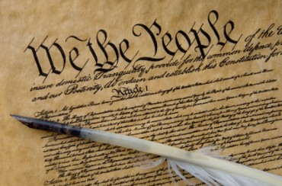
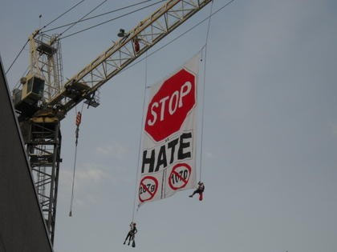
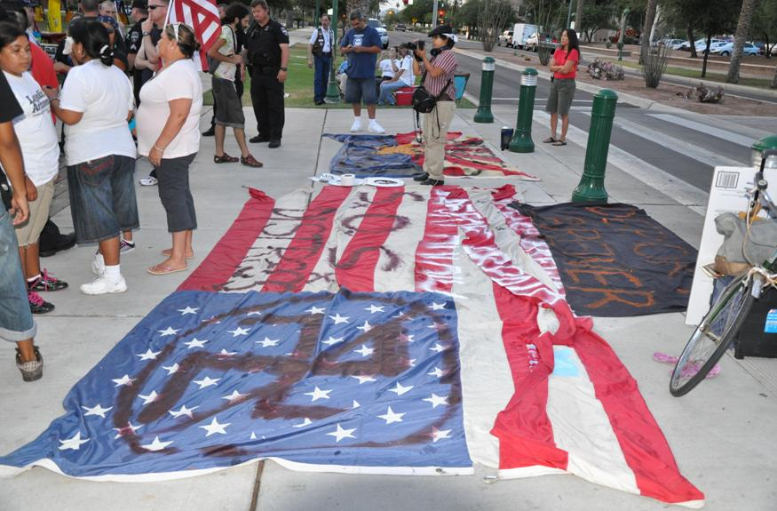
1070 Constitutional Question

Slide 27
1070 Constitutional Question
Article III Section 2
In all cases affecting ambassadors, other public ministers and consuls, and those in which a State shall be party, the Supreme Court shall have original jurisdiction. In all the other cases before mentioned, the Supreme Court shall have appellate jurisdiction, both as to law and fact, with such exceptions, and under such regulations as the Congress shall make.

Slide 28
S.B. 1070 Constitutional Question
?
The federal government sued Arizona thus making it a party to a case. Why was this heard in federal court and not the Supreme Court?

